Slide 1
Lesson 5 – Homework review

Slide 2


Use constructors correctly

Slide 3

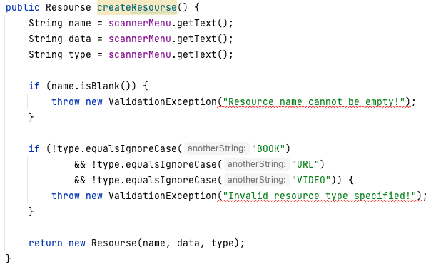
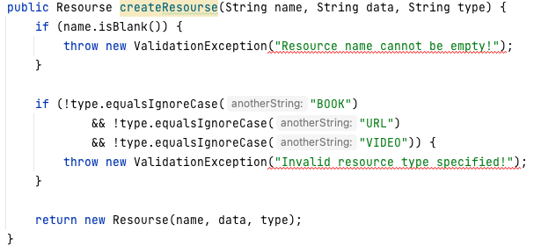
Make input data validation before object creation

Slide 4

Simplicity is the key

Slide 5
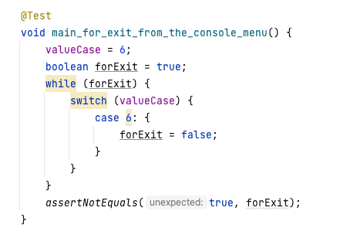

Don’t test java core

Slide 6


Follow code conventions

Slide 7
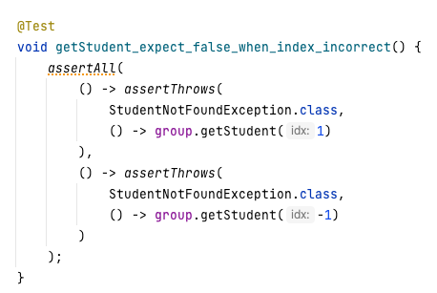


Test should test only one case

Slide 8

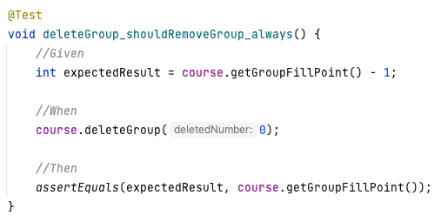
Given When Then Blocks

Slide 9


Follow conventions

Slide 10
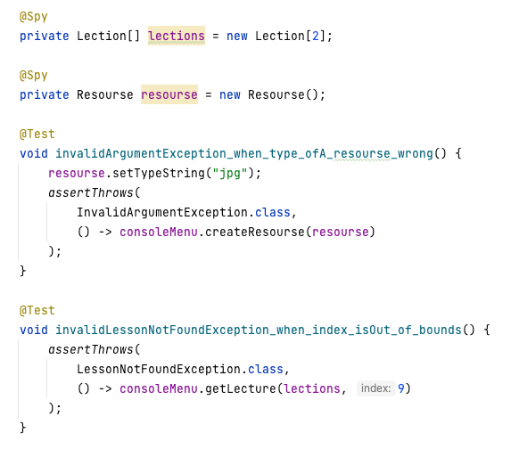
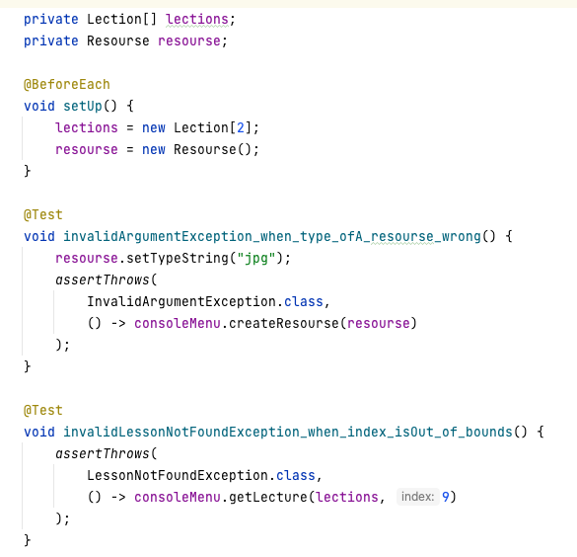
Don't over complicate

Slide 11
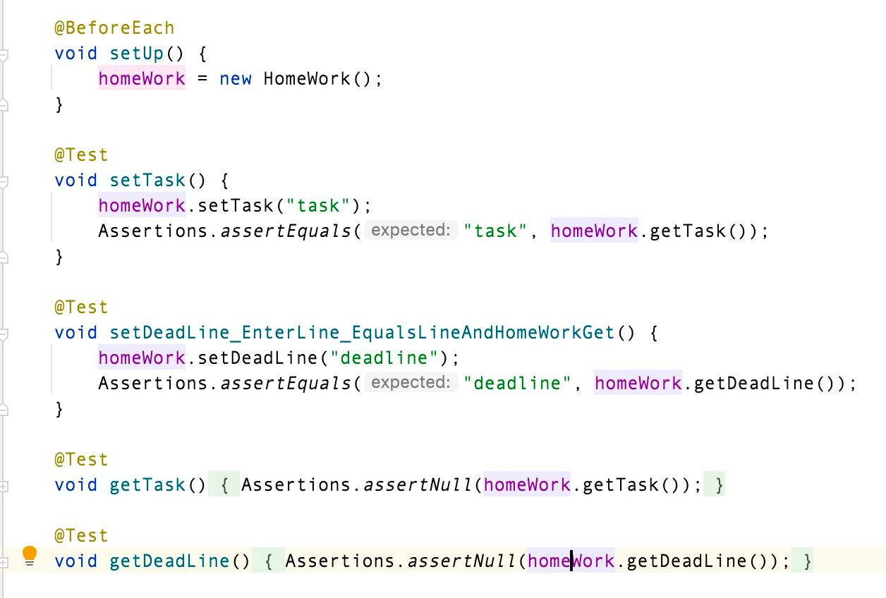
Write test for service, not for model.

Slide 12


FIX THIS!

